Slide 1

IPL Analysis
Created By :
Tanupriya Awasthi
Batch: June
Created On:
5Th October 2024

Slide 2
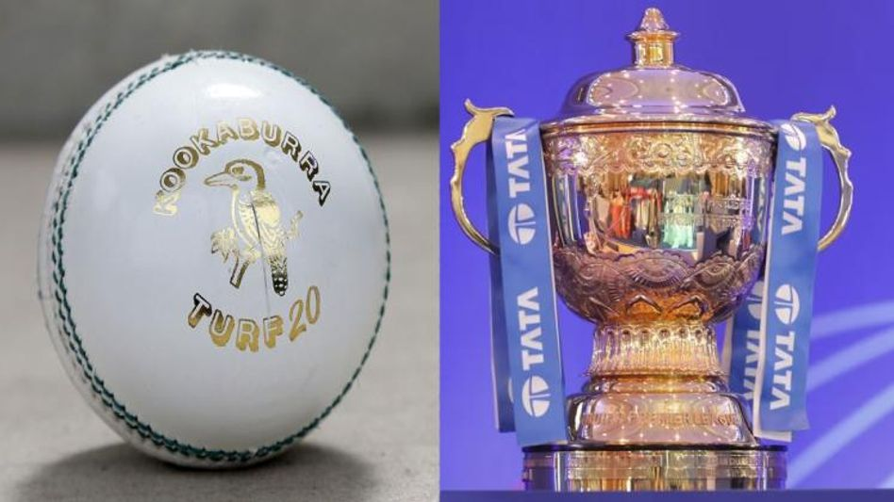
IPL Analysis: Indian Premier League
The Indian Premier League also known as IPL is an Indian professional Twenty20 (T20) cricket league established in 2008. The league is based on a round-robin group and knockout format and has teams in major Indian cities.
Over the years , IPL has evolved into a major sporting event that millions of people worldwide watch. The league has expanded and now has 10 teams.

Slide 3
Agenda
01
Problem Statement
02
Data Description
03
Objective Key Metrics and Visualizations
04
Subjective Question for Insights

Slide 4
Problem Statement
You are hired as a sport data analyst by RCB where the team is looking for top-performing and reliable players to win tournaments, considering both on-field performance and value for money in mega player auction of 2017.
Your task is to come up with strategies/suggestions regarding selecting the best-performing players and optimizing player auction investments

Slide 5
Methodology
While going through the data I first analyzed the data checked for duplicates and null values if any.
Then analyzed the tables and the relation between the tables how they are connected to each other .
While answering to the question we used various statements like Select, Group by , Order by.
Where we need the data from one or more table , we used the concept of join in order to join one or more tables together in order to get the desired result.
We also used aggregate function like Sum, Average , Count distinct , Max , Min.
We also used the rank function in order to rank players on the basis of their batting average , strike rate.
We also used DDL commands where using the create function we created a table .
We also used DML commands where we inserted and even updated the table.
Therefore while working on the project we have used various function under the various commands available in SQL and developed the insights for the analysis.

Slide 6
Data Description
Ball by Ball
Match_id: Unique identifier for a cricket match
Over_id: Unique identifier for an over in a cricket match
Ball_id: Unique identifier for a ball in an over
Innings_No: The innings number in a cricket match
Team_Batting: The team batting in a particular innings
Team_Bowling: The team bowling in a particular innings
Striker_Batting_Position: The batting position of the striker batsman
Striker: The batsman currently on strike
Batting style
Batting_id: Unique identifier for a batsman's batting record
Batting_hand: The batting hand (right or left) of a batsman
Bowling style
Bowling_id: Unique identifier for a bowler's bowling record
Bowling_skill: The bowling skill (e.g., right-arm fast, left-arm spin) of a bowler
City
City_id: Unique identifier for a city
City_Name: The name of a city
Country_id: Unique identifier for a country

Slide 7

Extra Type
Extra_Type_Id: Unique identifier for the type of extra runs scored in a cricket match.
Extra_Runs: The number of extra runs scored in a particular delivery.
Innings_No: The innings number in a cricket match.
Extra_Id: Unique identifier for an instance of extra runs scored.
Extra_Name: The name or description of the type of extra runs scored (e.g., byes, leg byes, wides, no-balls).
Season
Season_Id: Unique identifier for a particular season or tournament.
Venue_Id: Unique identifier for the venue or stadium where the match is played..
Win_By
Win_Type: The type of win (e.g., runs, wickets) achieved by the winning team.
Win_Margin: The margin of victory (e.g., runs or wickets) for the winning team.
Outcome
Outcome_type: The type of outcome or result of the match (e.g., win, loss, tie, no result).
Match_Winner: The team that won the match.
Man_of_the_Match: The player awarded the Man of the Match award.

Slide 8
Rolee
Role_Id: Unique identifier for a player's role or skills (e.g., batsman, bowler, all-rounder).
Role_Desc: Description of a player's role or skills.
Man_of_the_Series: The player awarded the Man of the Series award for a particular tournament.
Orange_cap: The player awarded the Orange Cap (for most runs scored) in a particular tournament.
Purple_cap: The player awarded the Purple Cap (for most wickets taken) in a particular tournament.
Team
Team_Id: Unique identifier for a team.
Team_Name: The name of a team.
Umpire
Umpire_id: Unique identifier for an umpire officiating the match.
Umpire_name: The name of an umpire.
Umpire_country: The country or nationality of an umpire.
Player
Player_Id: Unique identifier for a player.
Player_Name: The name of a player.
Out_Type
Out_Id: Unique identifier for the type of dismissal or way a batsman got out.
Out_Name: The name or description of the type of dismissal (e.g., caught, bowled, lbw, run out).
Outcome_Id: Unique identifier for the outcome or result of a match.

Slide 9
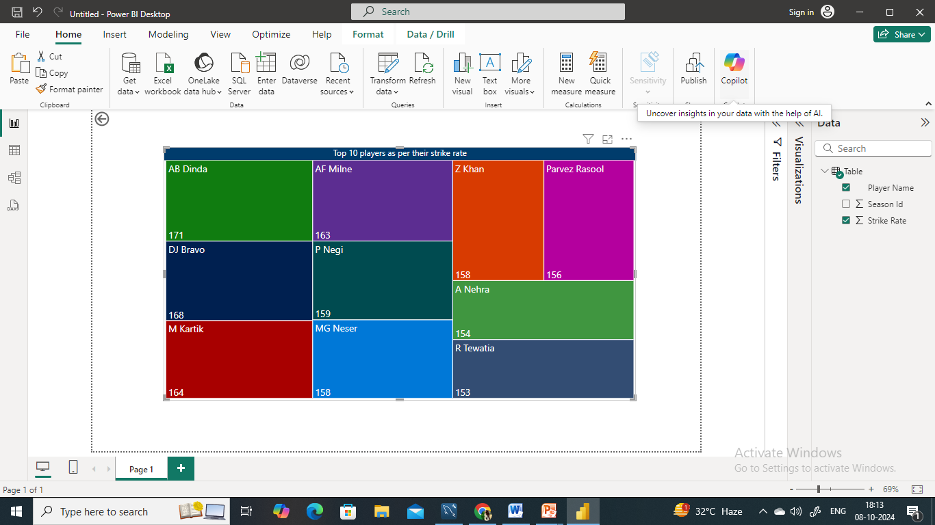
Objective Key Metrics and Visualizations
Top 10 player according to their strike rate in last four season.
In this visual we can see the top 10 player on the basis of their strike rate . The bigger the box the higher the performance.

Slide 10
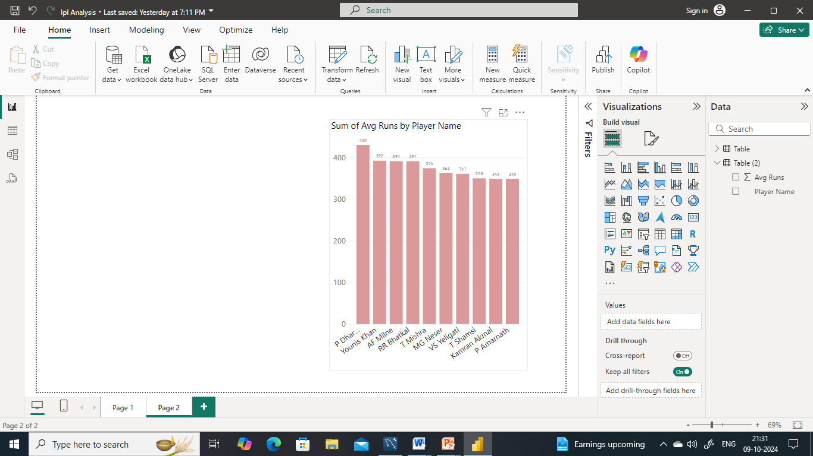
Average runs scored by each batsman
Here in the column chart we can see the average runs scored by each batsman.
We have taken the top 10 batsman on the basis of the average runs scored by them .
From this we can see that P Dharmani stands out with the highest average runs 430.
There are some players whose average runs are almost same means they performance is more or less than same.
There is a gradual decrease in the average runs as you move down the list

Slide 11
Average Wickets taken by each bowler
This chart shows the average wickets taken by each bowler .
We have taken top 10 players for the visualization .
In this chart we can see that Ashish Reddy stands first with 15 of average wickets followed by A Chandila with 14.3 average wickets taken.

Slide 12
Players whose performance is suited to specific venues and conditions
In this column chart , we can see the players whose performance is much suited to specific venues and conditions.
One bar represents the average runs scored at venue and the other bar represents the overall average runs.
We can see that all the players listed here performs well at specific venue as compared to other stadiums .

Slide 13
Parameters kept in mind while selecting the players
There are some parameters that must be considered while selecting the players that should be best fit for the team
Batting Performance: Total runs scored, Batting Average , Strike rate
Bowling Performance: Total wickets taken, Bowling Average, Economy Rate, Strike Rate
Experienced and Young players: The team must consist of both experienced as well as young players .Young players are full of enthusiasm whereas experienced players know the strategy to play under pressure and how to handle the situation.

Slide 14
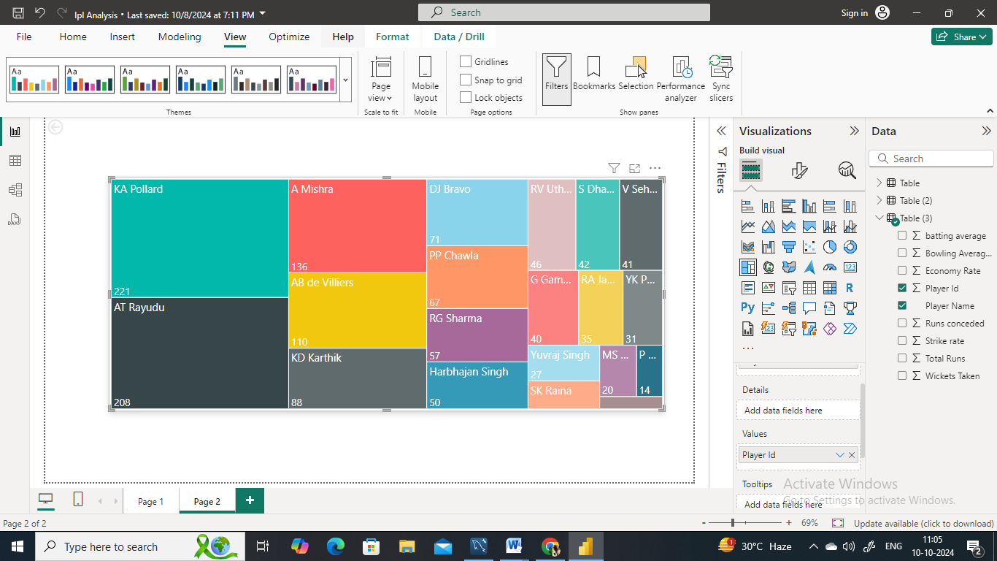
Players that would be best fit for the team
Here in the treemap we can see the name od some players with their Player Id.
On the basis of some metrics like strike rate, batting average, average runs scored economy rate.
Considering all these metrics we have come out with the names of top 20 players who would be the best fit for the team.

Slide 15
RCB's past season performances
High number of losses: The "Losses" line in the graph indicates that RCB has experienced a significant number of losses over the past seasons..
Inability to score high runs: The "Avg_Runs_Scored" line in the graph suggests that RCB's average runs scored per match is not exceptionally high..
Struggles in conceding runs: The. Conceding high scores makes it harder for the team to consistently win matches, which is essential for IPL trophy success.

Slide 16
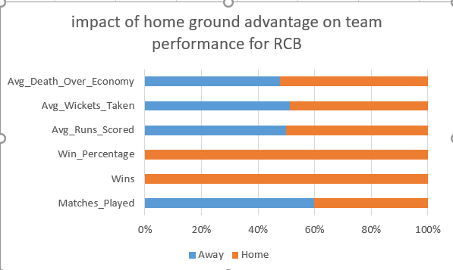
Impact of home ground advantage on team performance
RCB struggles to defend runs at the death when playing at their home ground, suggesting the need to improve their death bowling strategies.
The home pitch conditions appear to be more favorable for RCB's bowlers, allowing them to take more wickets at home compared to away matches.
RCB scores more runs on average when playing at home, indicating the home ground conditions are conducive to their batting lineup.

Slide 17
Emerging Talent
Ishan Kishan: The young wicketkeeper-batsman has impressed with his power-hitting abilities and consistency. Ishan, with his aggressive batting style has displayed fearlessness in top order, showcasing his ability to take on any bowling attack.
Arshdeep Singh: With his precise left arm swing bowling has become a go-to death bowler. His ability to bowl pinpoint yorkers and remain cool under pressure makes him a asset in tough situations.
Umran Malik: The fast bowler has captivated audiences with his raw pace and ability to bowl yorkers consistently

Slide 18
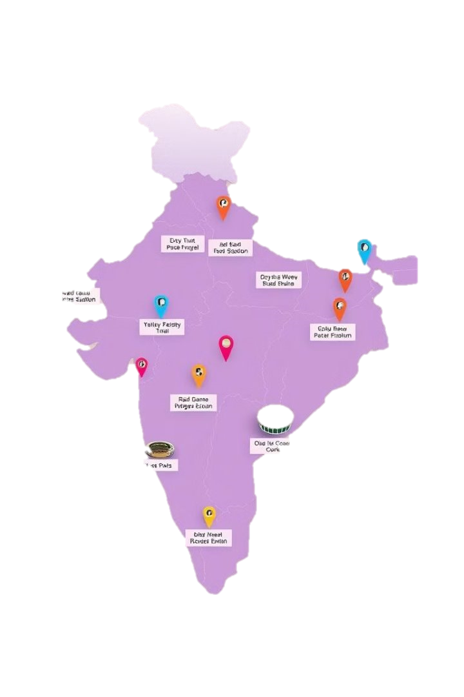
Venue Specific trends
Home Ground Advantage: We see that teams often perform great at their home ground as they are familiar with the pitch conditions and they have done practiced on the same.
Player suitability: Pitch conditions varies from venue to venue, but the adaptable players perform great across different conditions.
Fan support: The support from the home ground boost the morale of the players and encourages them to play with full energy and enhances their performance.

Slide 19
Predictions
The league is expected to become even more competitive with the increase in the new teams and emerging young players with their different batting and bowling style.
The IPL continues to have a global impact and attract international players and keeps on welcoming new talent and inspiring the new generation of cricket fans.
We see that the cricket supporters has increased and are supporting their favorite players. Today we see a huge crowd in the stadiums which shows now there big fan following of cricket.

Slide 20
Suggestions for RCB before going to mega auction
Before going to mega auction I would like to suggest the RCB to look for the batsman who can perform well in death overs and focus on their strike rate .
In case when choosing for the bowlers the RCB should look for the bowlers whose economy rate is low as the lower economy rate indicate a bowler is more effective at preventing the opposing team from scoring the runs.
Not only batsman and bowlers the RCB should have at least 4 all rounders whose batting as well as bowling average is good and economy rate is also low.

Slide 21
The RCB should have experienced players as well as the younger players because the experience can be used in building the strategy to win the match and the young players have different bowling and batting style and have new strategy
Also we see historically the RCB has always rely on the top order batsman and the middle order keep struggling under pressure. So RCB should strengthen his middle over. For this RCB should look for the players with the consistent batting average and strike rate under pressure.
We also see that the team often succeed in middle overs has effective spinners. So RCB should look for spinners who have a low economy rate in middle overs.
As per me , these are some of the important points that RCB should focus on before going to mega auction.

Slide 22
References
Data provided by Newton School.
Used google for images and some data to get knowledge about the cricket and its terms.
Applications Used: Used Microsoft Word for documentation, Microsoft Power point for ppt and Microsoft excel and Power BI for creating Visuals. Used SQL for querying.

Slide 23

THANK YOU

